Slide 1
FLAUNT
The one stop shop for all your beauty and lifestyle needs
Team 2 Presentation

Slide 2

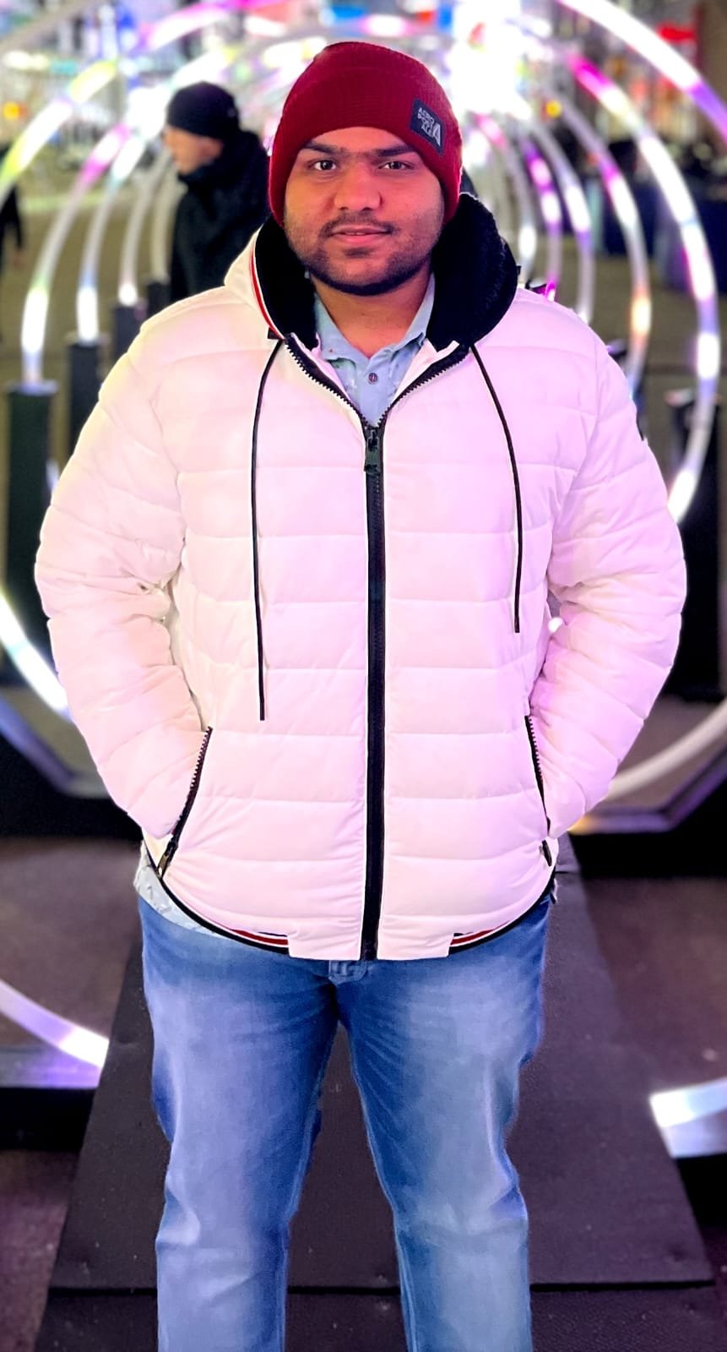
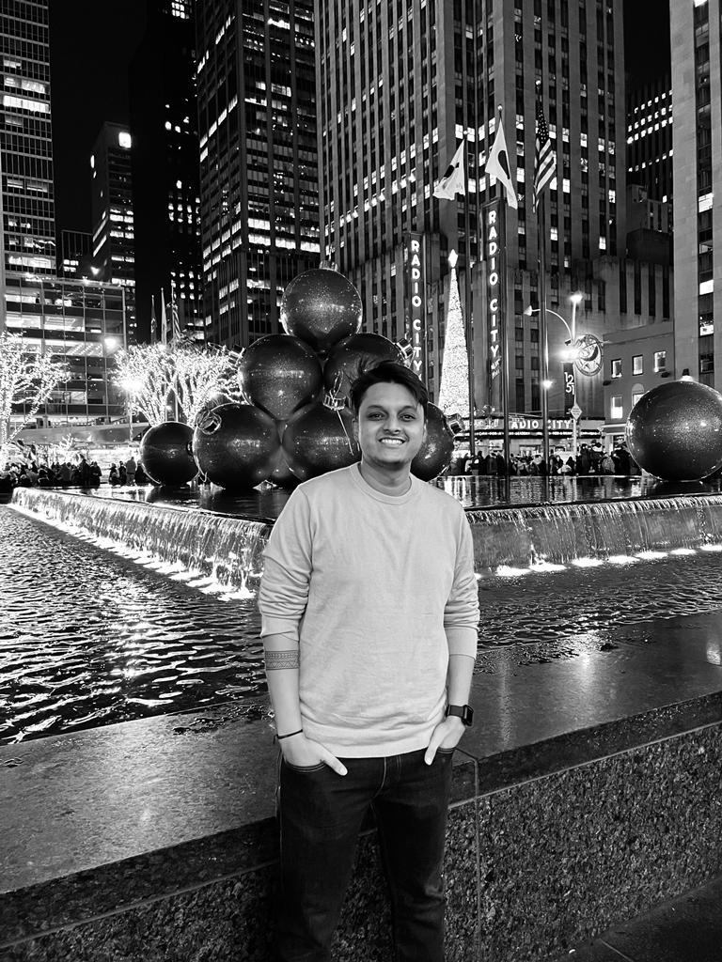
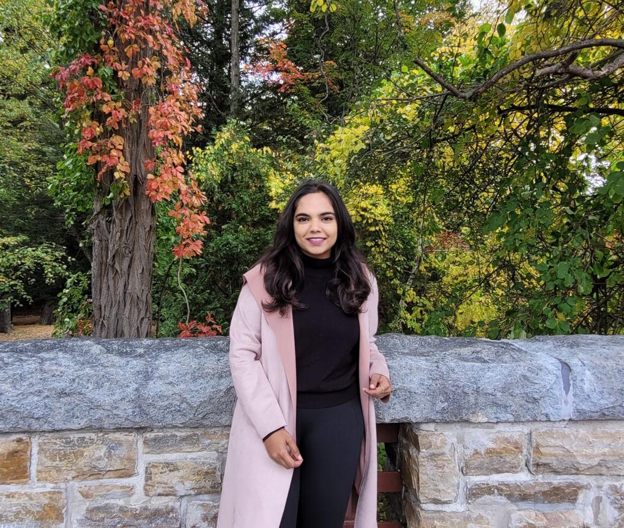
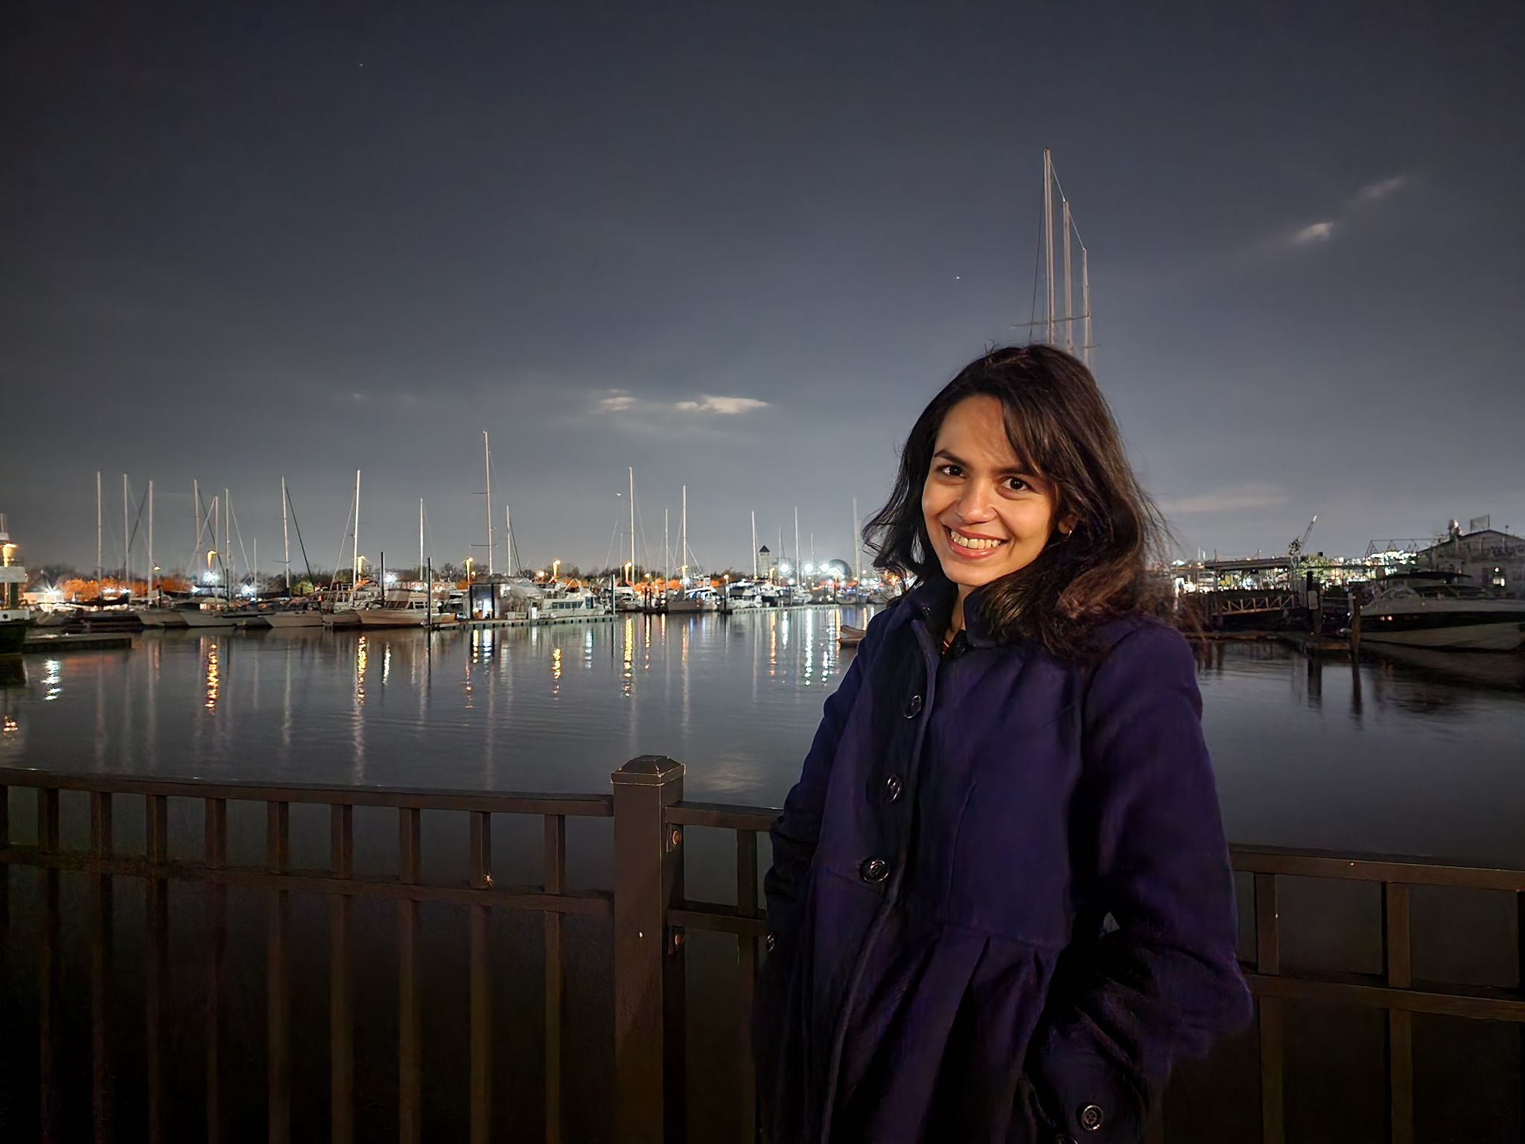
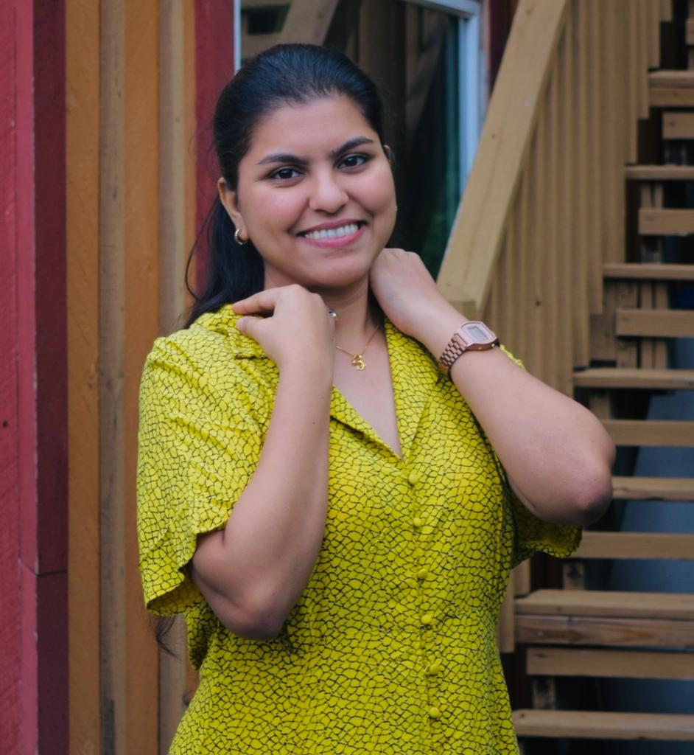
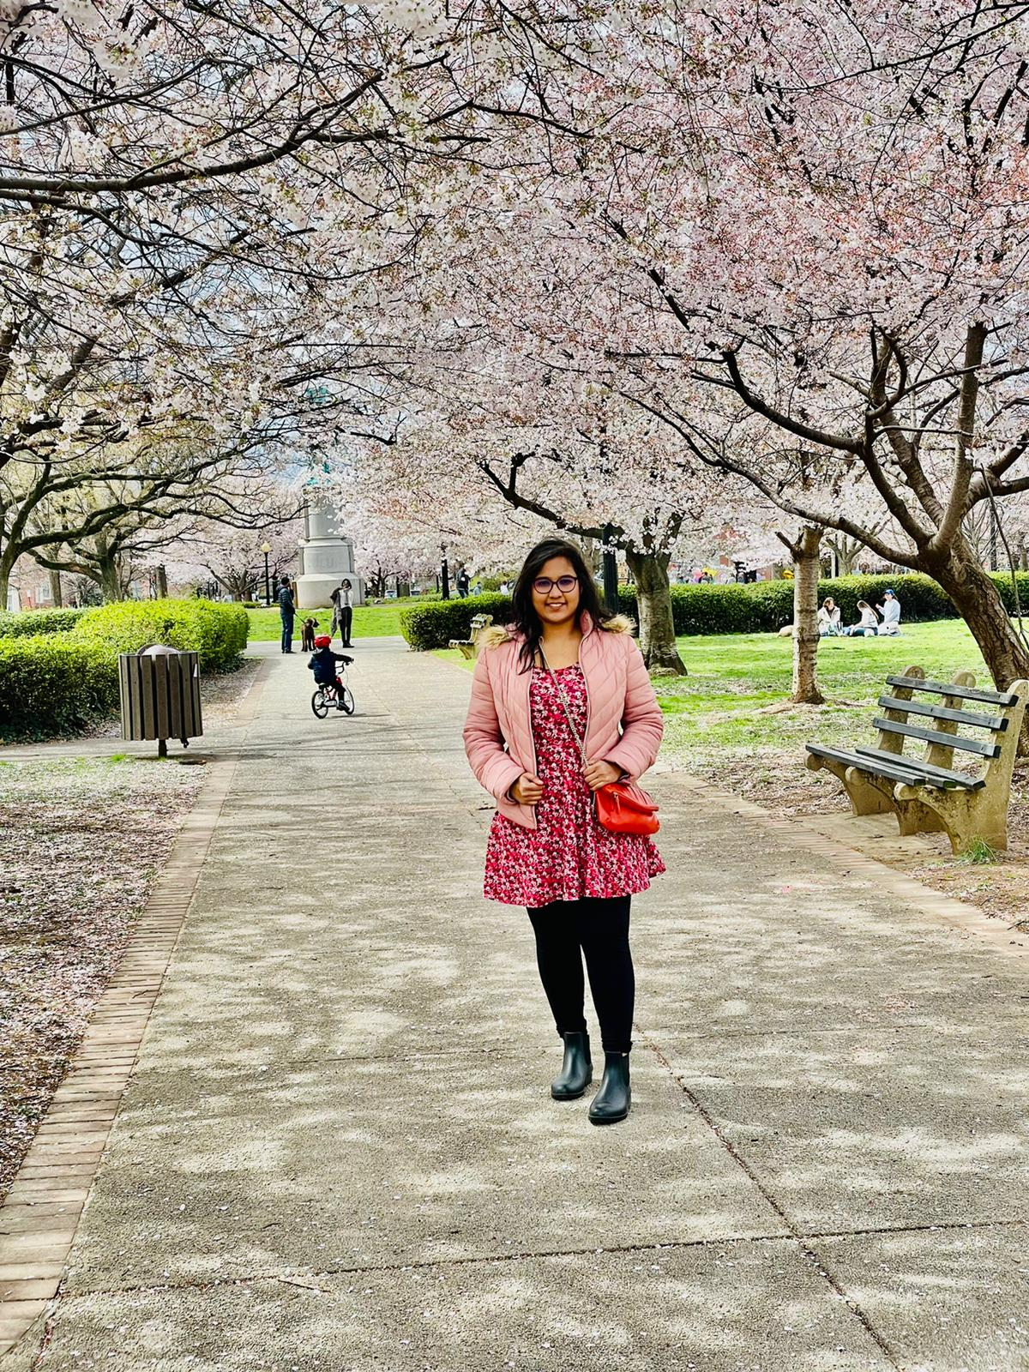
Kaneshk K Sonee - Project Manager
Tushar Varma - Lead Developer
Neerav Poriya - DBA
Chandini N - QA Tester
Limisha Oliveira - Product Owner
Sayali Tandel - Business Analyst
Neha Chudekar - QA Analyst

Slide 3
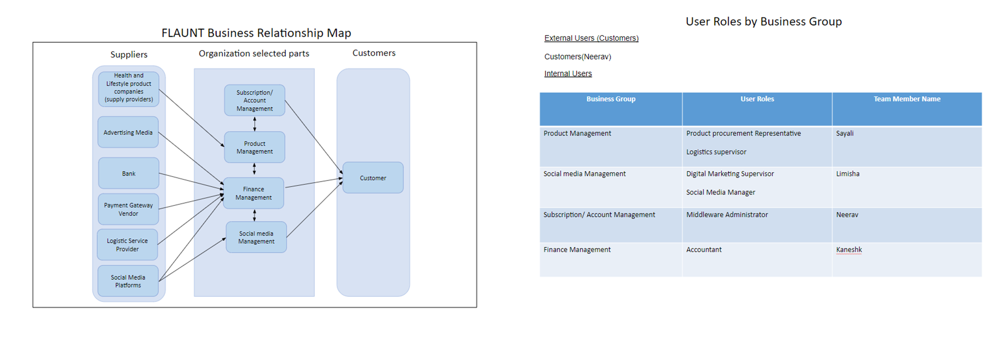
BRM DIAGRAM, USER ROLES (Limisha)
https://docs.google.com/presentation/d/1MCx2FnnOjZAzSMecG1ix6S7e6f8Vi6m5/edit#slide=id.p1

Slide 4
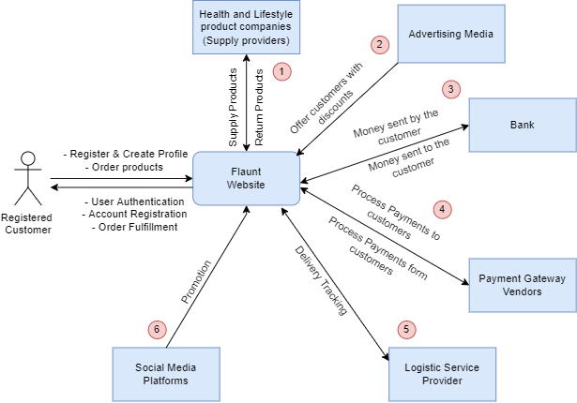
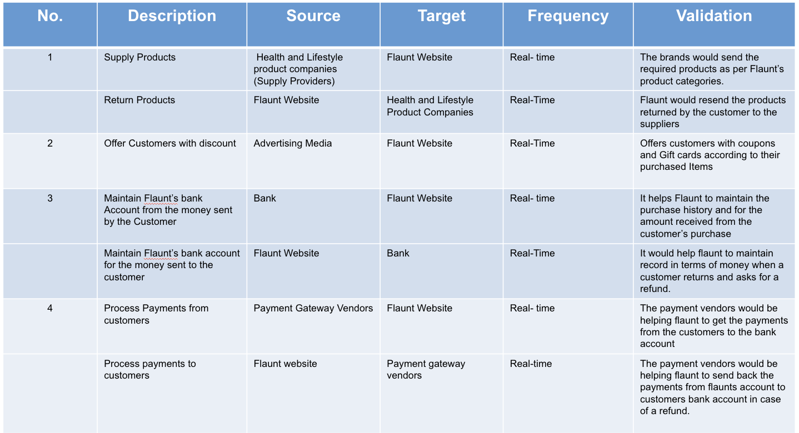
CONTEXT DIAGRAM; SYSTEM INTERFACE TABLE (Sayali)
https://docs.google.com/presentation/d/1MBCrcIzX1V7RSWqXLAR0uXztgHkYM9XQ/edit?usp=sharing&ouid=106770456127709376743&rtpof=true&sd=true

Slide 5
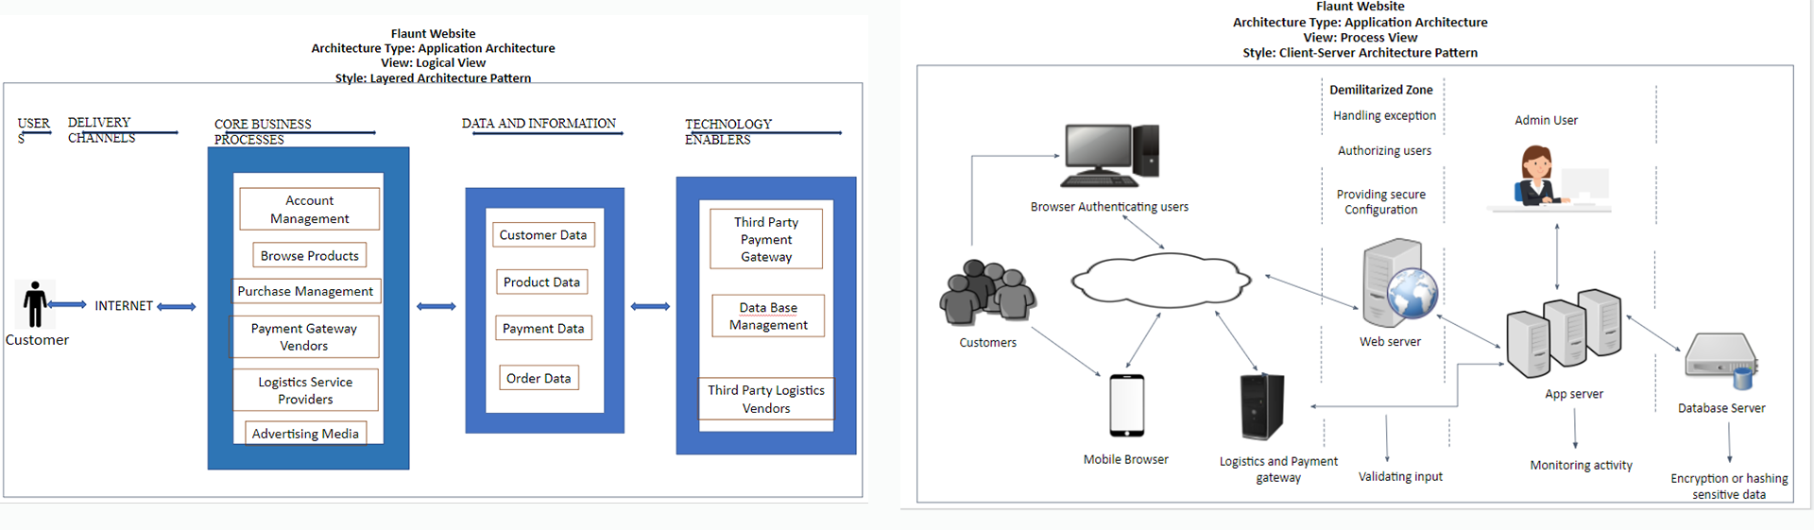
ARCHITECTURE DIAGRAMS (LOGICAL, PROCESS VIEWS) (Neerav)
https://docs.google.com/presentation/d/1MOG4PCn1nB0sbnNDucTDPMwi16XkFFS_/edit#slide=id.p1

Slide 6
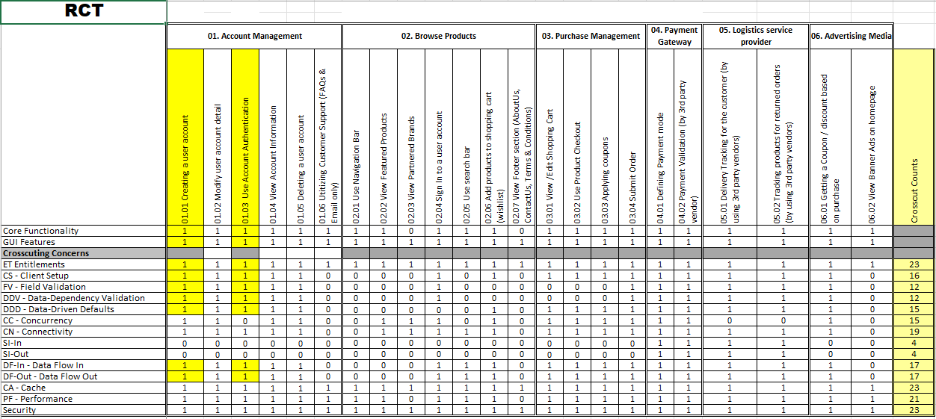
RCT (INCLUDES FUNC. DECOMP., SUPPL. REQS) (Kaneshk K Sonee) https://docs.google.com/spreadsheets/d/1MFs4zLJ_uHTMp5pZb_6No56yubgK_P9L/edit#gid=1409949409

Slide 7
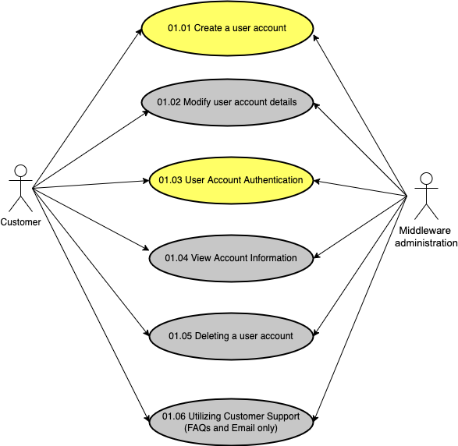
USE-CASE DIAGRAMS (UML)(Sayali)
https://docs.google.com/presentation/d/1MNJwS8O9S7dV_WuwjErM1T5Gkl1Ky6VD/edit?usp=sharing&ouid=106770456127709376743&rtpof=true&sd=true

Slide 8
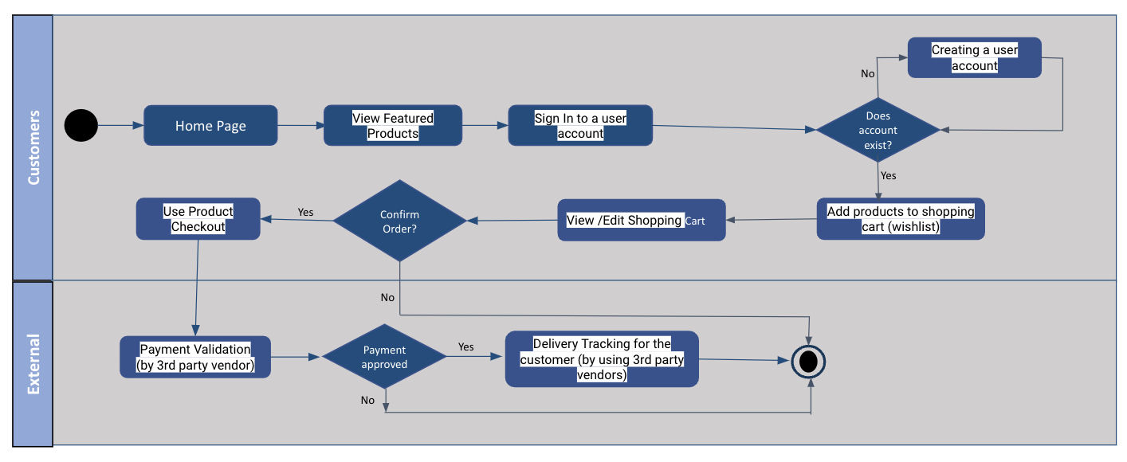
ACTIVITY DIAGRAM (UML) (Chandini)
https://docs.google.com/presentation/d/1MBCrcIzX1V7RSWqXLAR0uXztgHkYM9XQ/edit?usp=sharing&ouid=106770456127709376743&rtpof=true&sd=true

Slide 9
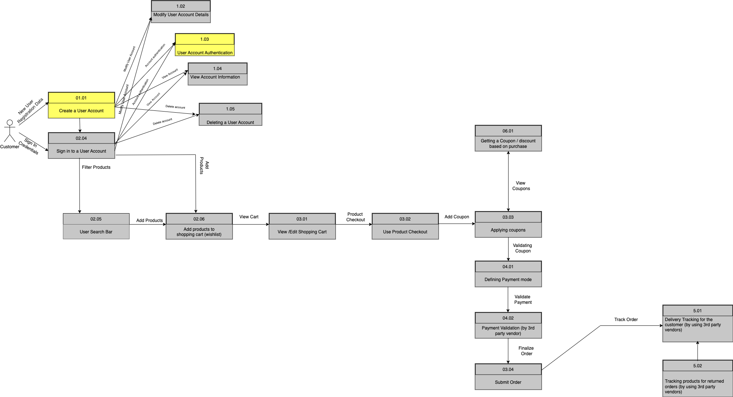
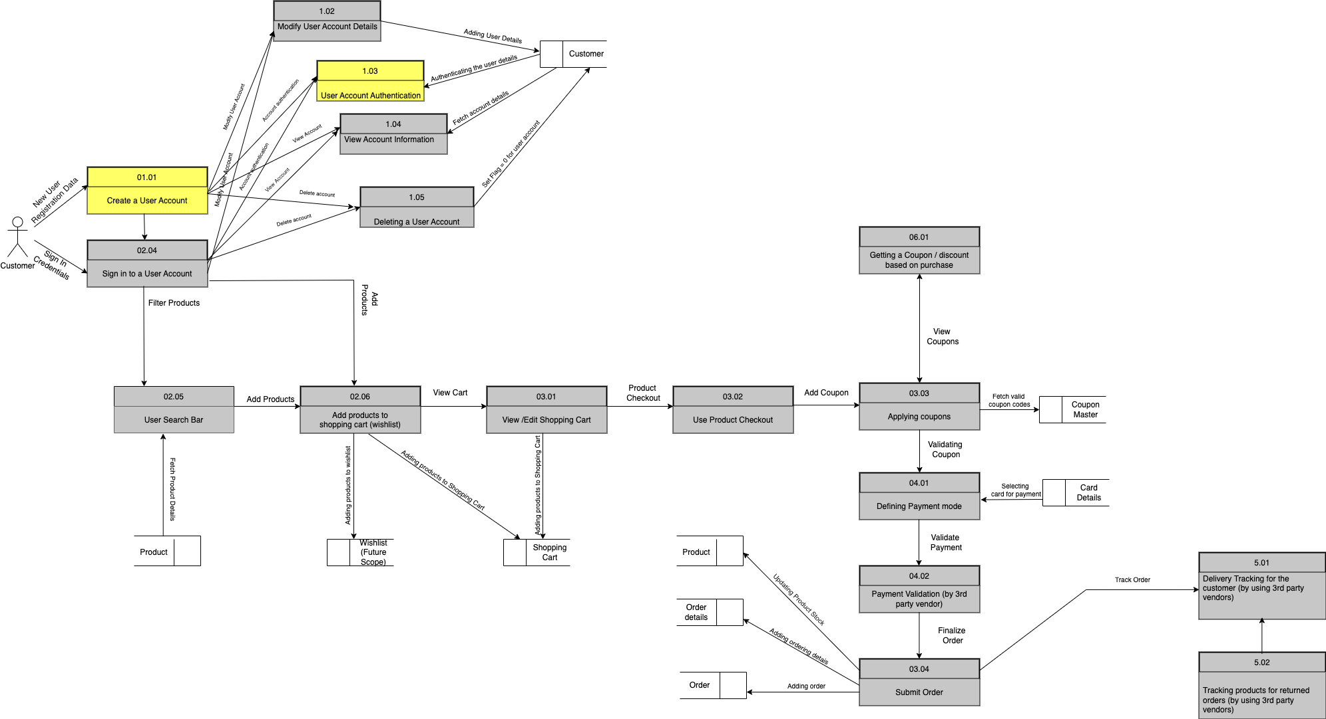
DATA-FLOW DIAGRAMS (LOGICAL, PHYSICAL)(Chandini)
https://docs.google.com/presentation/d/1N-8GEKBTk4j7kr5kTseJ1lTpifDwqILs/edit?usp=sharing&ouid=106770456127709376743&rtpof=true&sd=true

Slide 10
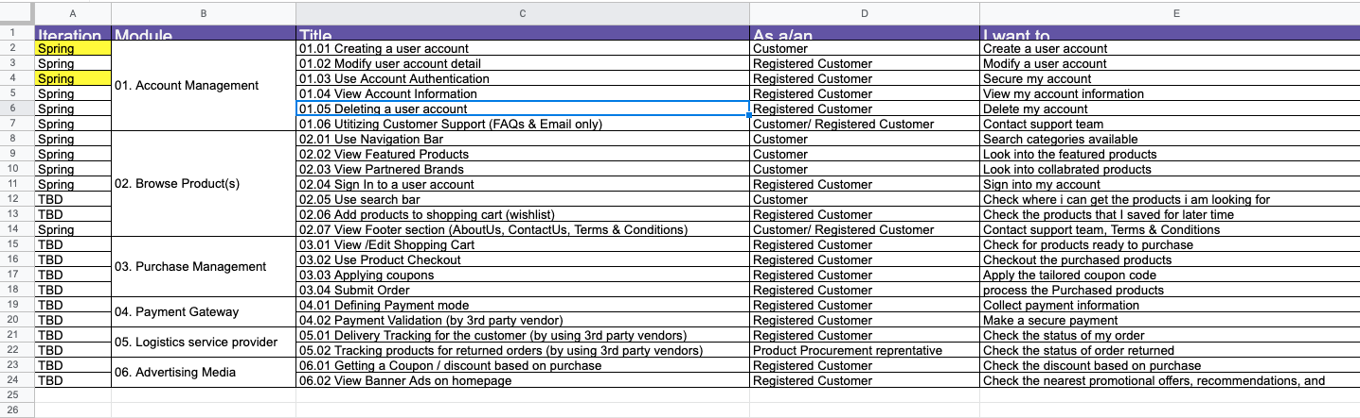
FUNCTIONAL REQUIREMENTS (USER STORIES) (Neha)
https://docs.google.com/spreadsheets/d/1ME-P2D-Stkb6zaTJigVD0Rl5zSXelz6L/edit#gid=1348446109

Slide 11
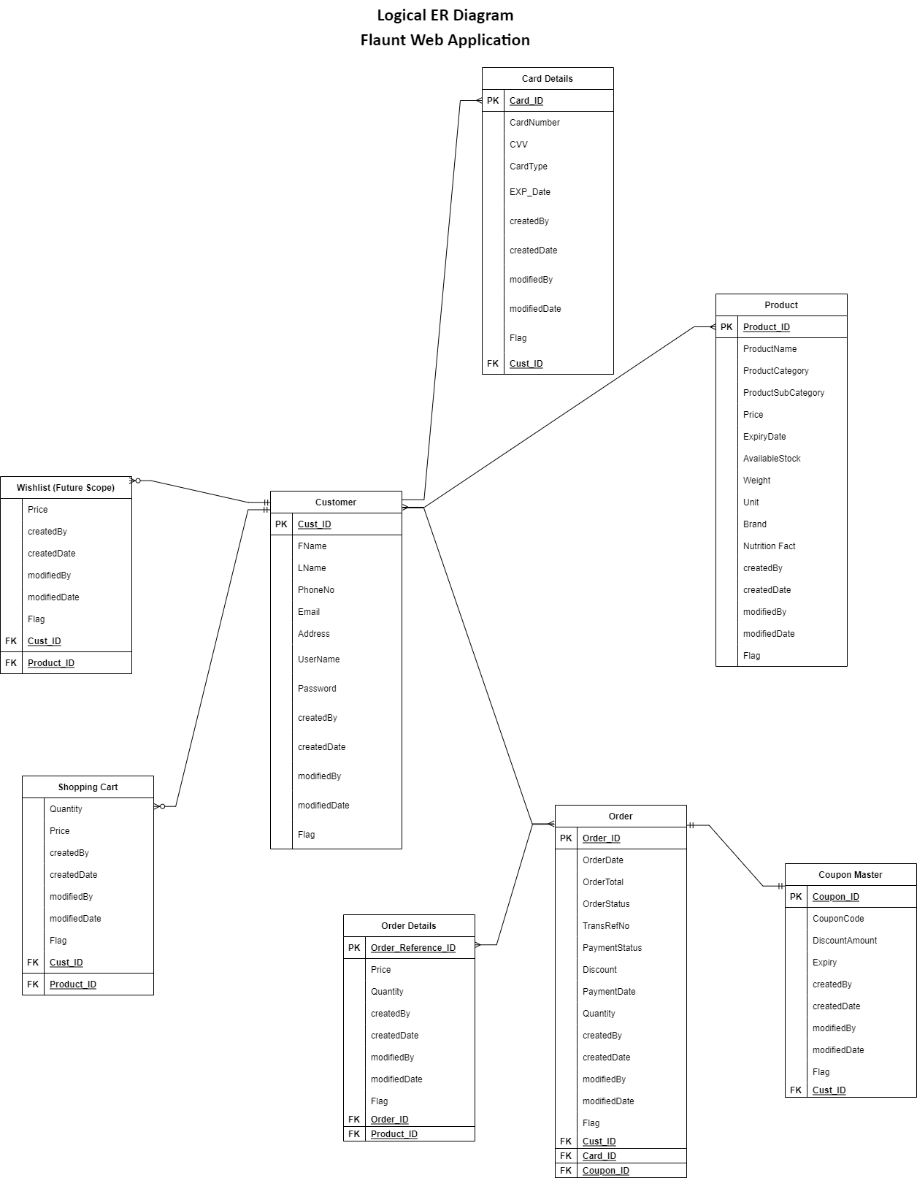
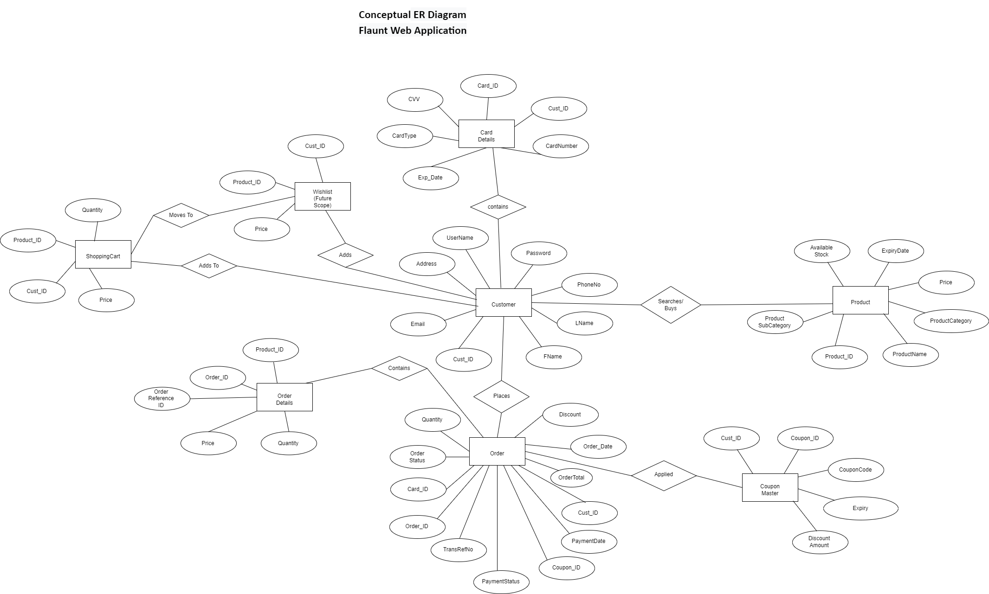
ER DIAGRAMS (CONCEPTUAL, LOGICAL) (Neerav)
https://docs.google.com/presentation/d/1MWNT3NUMrJ-XovDrd0pN7j-v-zWfyfJd/edit#slide=id.p2

Slide 12
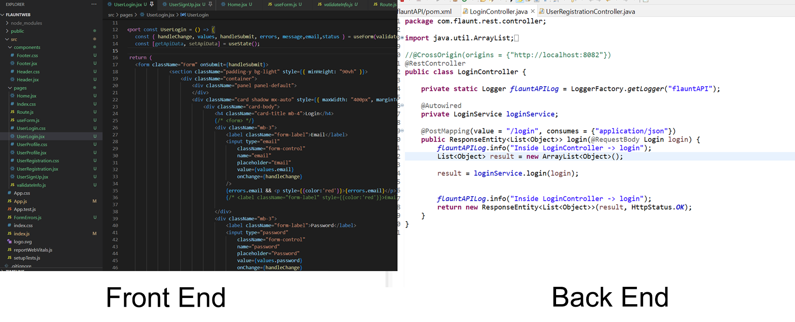
SOURCE CODE - Flaunt (Tushar)

Slide 13
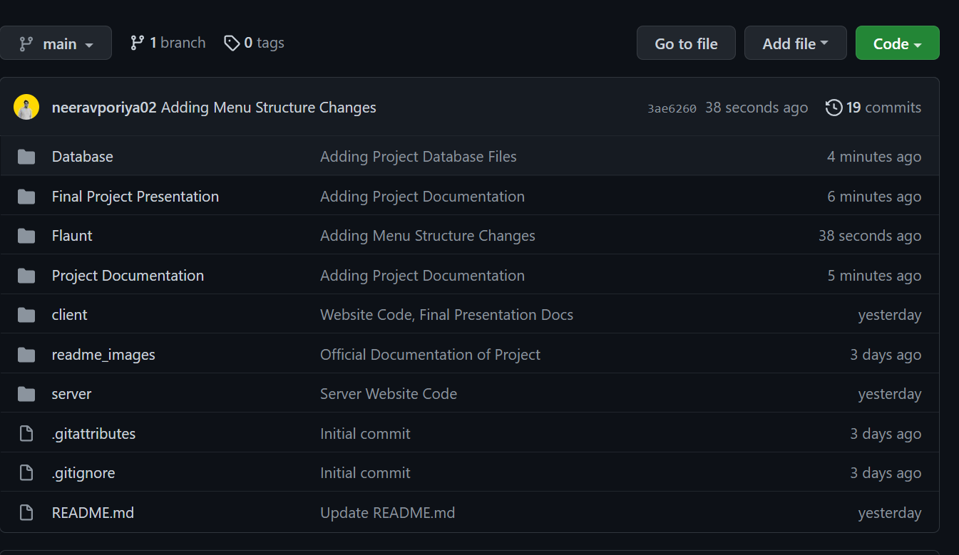
GITHUB REPOSITORY SLIDES (Tushar)
Github Handy Helper

Slide 14
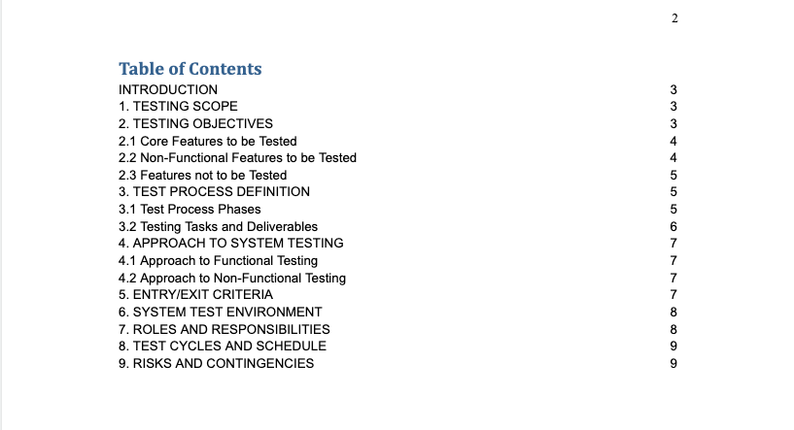
TEST PLAN DOCUMENT (Neha)
https://docs.google.com/document/d/1MkpVZZvtVYnwPtXFDlYLmoGSy4kEmzd-/edit

Slide 15
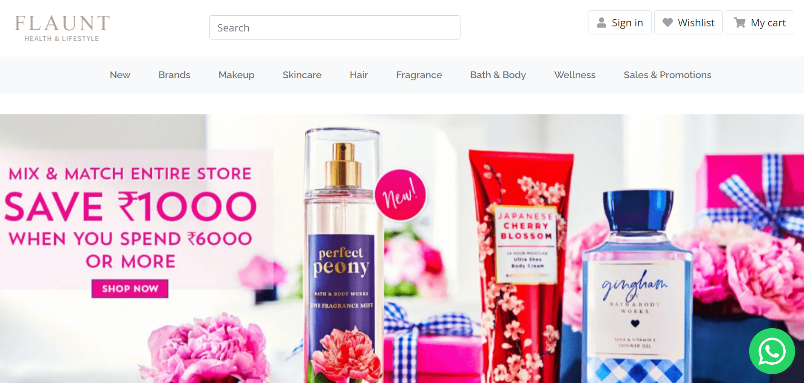
APPLICATION DEMO
https://drive.google.com/file/d/19k9015KPB2E6QmcelMKPpGfrgWfie1vv/view?usp=sharing

